Slide 1
Question Answering
Jurafsky and Martin Chapter 22
Notes:
Stanford Question Answering Dataset (SQuAD) consists of passages from Wikipedia and associated questions whose answers are spans from the passage, for just over150,000 questions.

Slide 2
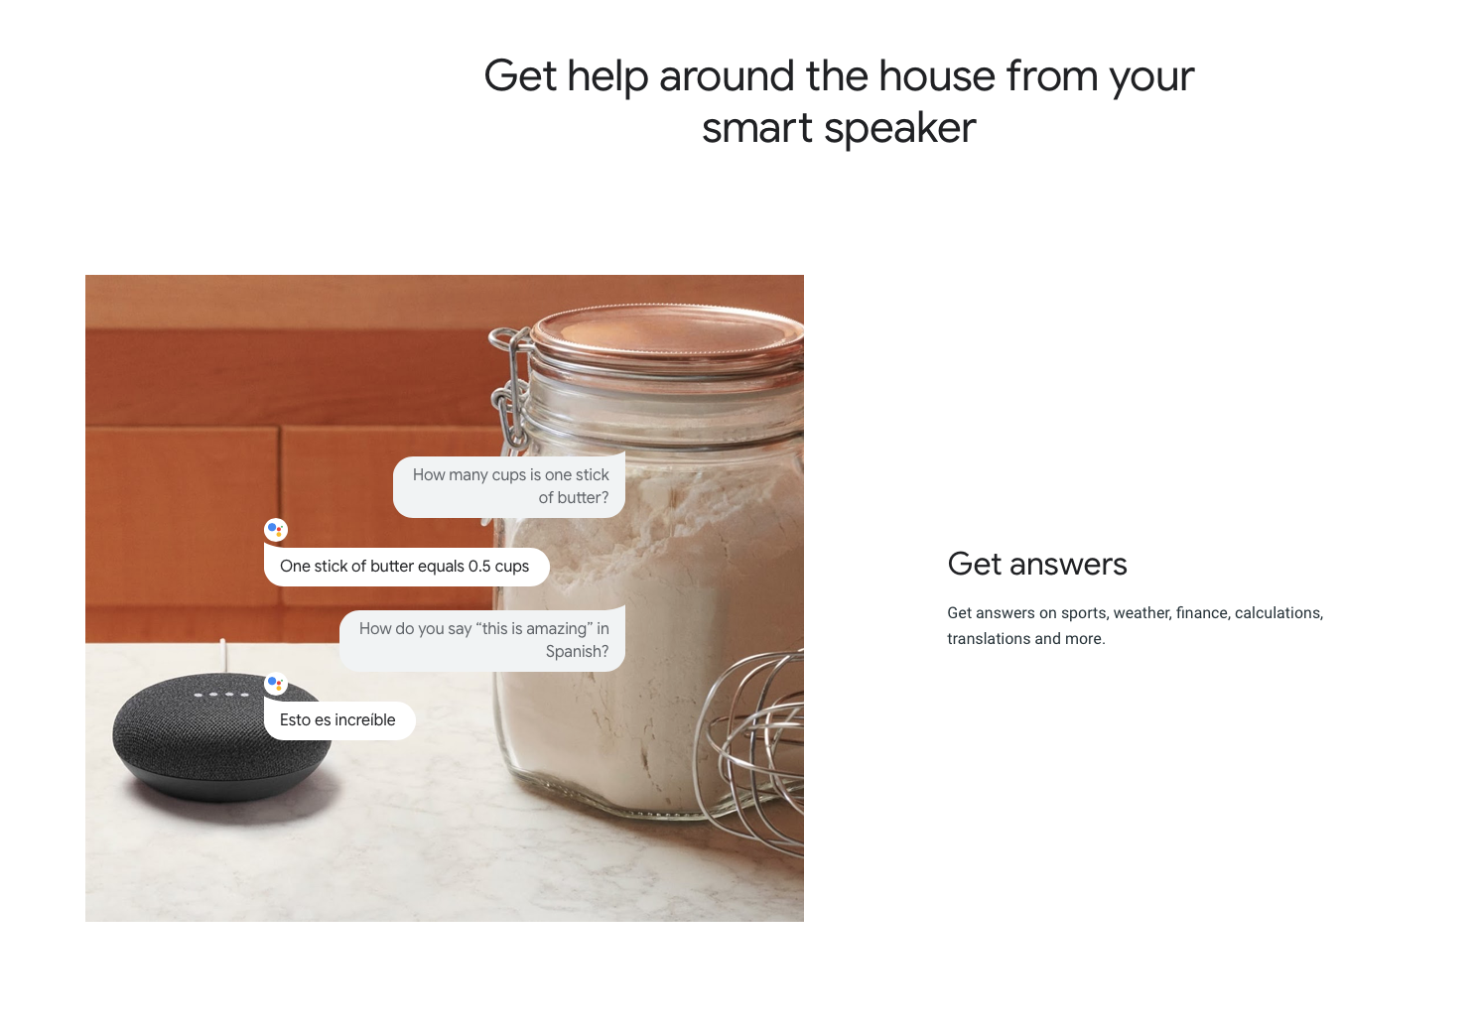

Slide 3
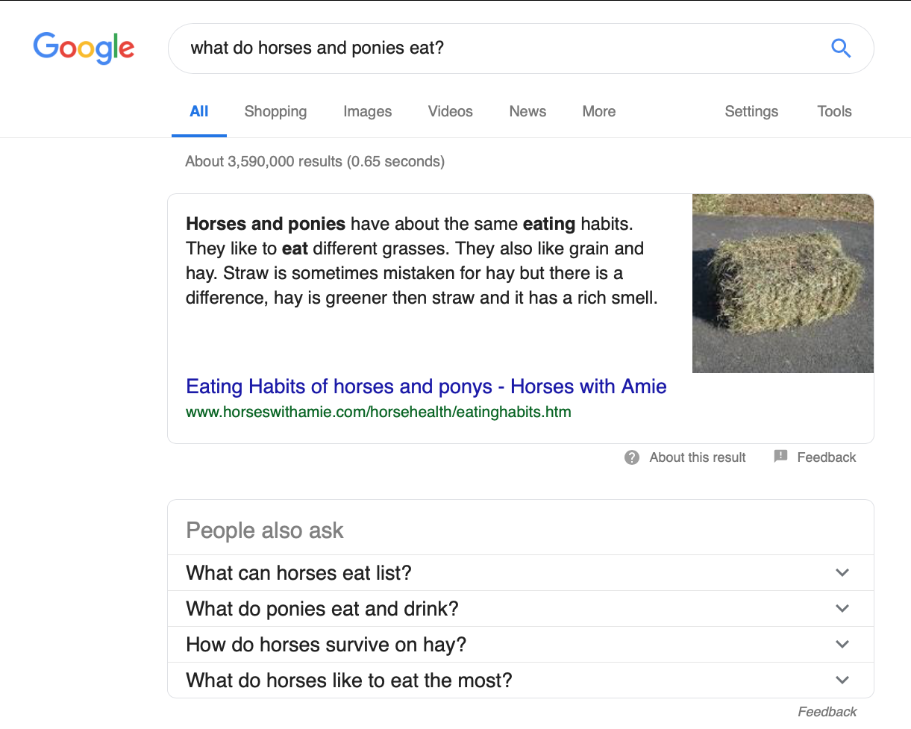
Notes:
Asked by my 5-year-old today.

Slide 4
Information Retrieval-based Question Answering
Question | Answer
Where is the Louvre Museum located? | in Paris, France
What’s the abbreviation for limited partnership? | L.P.
What are the names of Odin’s ravens? | Huginn and Muninn
What currency is used in China? | the yuan
What kind of nuts are used in marzipan? | almonds
What instrument does Max Roach play? | drums
What’s the official language of Algeria? | Arabic
How many pounds are there in a stone? | 14
Notes:
Most question answering systems focus on factoid questions, questions that can be answered with simple facts expressed in short texts. The answers to the questions below can expressed by a personal name, temporal expression, or location

Slide 5
Pipeline for IR based factoid answering

Slide 6
Question Processing
answer type: the entity type (person, location, time, etc.) focus: the string of words in the question that are likely to be replaced by the answer in any answer string found. question type: is this a definition question, a math question, a list question?
Which US state capital has the largest population?
query: “US state capital has the largest population” answer type: city focus: state capital

Slide 7
Query formulation
Goal: create a query to send to an information retrieval system to retrieve documents that might contain answer strings.
Input | Reformulation Rule | Output
when was the laser invented? | wh-word did A verb B → ...A verb+ed B | the laser was invented
where is the Valley of the Kings? | wh-word did A verb B → ...A verb+ed B | the Valley of the Kings is located in
Notes:
Query = a list of tokens
In addition to the web, IR engines might index corporate intranets, or specific resources like Wikipedia. we still use an IR engine to index and search our documents, generally using standard tf-idf cosine matching.

Slide 8
Answer types
Some systems make use of question classification, which is the the task of finding the answer type, which is the category of the answer, often based on named entity types.
Question | Expected Answer Type
Who founded Virgin Airlines? | PERSON
Who is Elon Musk? | BIOGRAPHY
Where is the Statue of Liberty located? | LOCATION
What is the state with the largest population? | STATE
What is the state flower of California? | FLOWER
Notes:
What is the state flower of California?
Head word: flower

Slide 9
Notes:
“What is Rocky?”
Answer Type: Movie
Distractors: Superbowl victors, Museums

Slide 10
Answer types

Slide 11
Entity Type | Example
animal | What are the names of Odin’s ravens?
body | What part of your body contains the corpus callosum?
color | What colors make up a rainbow?
creative | In what book can I find the story of Aladdin?
currency | What currency is used in China?
disease/medicine | What does Salk vaccine prevent?
event | What war involved the battle of Chapultepec?
food | What kind of nuts are used in marzipan?
instrument | What instrument does Max Roach play?
lang | What’s the official language of Algeria?
letter | What letter appears on the cold-water tap in Spain?
other | What is the name of King Arthur’s sword?
plant | What are some fragrant white climbing roses?
product | What is the fastest computer?
religion | What religion has the most members?
sport | What was the name of the ball game played by the Mayans?
substance | What fuel do airplanes use?
symbol | What is the chemical symbol for nitrogen?
technique | What is the best way to remove wallpaper?
term | How do you say “ Grandma” in Irish?
vehicle | What was the name of Captain Bligh’s ship?
word | What’s the singular of dice?
Notes:
Question typology from Xin Li and Dan Roth (2002), (2005). Example sentences are from their corpus of 5500 labeled questions. A question can be labeled either with a coarse- grained tag like HUMAN or NUMERIC or with a fine-grained tag like HUMAN:DESCRIPTION, HUMAN:GROUP, HUMAN:IND, and so on.

Slide 12
Document and Passage Retrieval
The question processing stage creates a query to send to an IR system, which returns a set of documents ranked by their relevance to the query.
Perform passage retrieval by divide the top ranked documents into smaller passages. Pass these along to the answer extraction phase or filter them based on answer type classification.
In web search, passage retrieval attempts to extract the snippets from the retrieved pages.
Notes:
The IR query produced from the question processing stage is sent to an IR engine, resulting in a set of documents ranked by their relevance to the query. Because most answer-extraction methods are designed to apply to smaller regions such as paragraphs, QA systems next divide the top n documents into smaller passages such as sections, paragraphs, or sentences. These might be already segmented in the source document or we might need to run a paragraph segmentation algorithm.
The simplest form of passage retrieval is then to simply pass along every pas- sages to the answer extraction stage. A more sophisticated variant is to filter the passages by running a named entity or answer type classification on the retrieved passages. Passages that don’t contain the answer type that was assigned to the ques- tion are discarded.

Slide 13
Features used to rank passages
The number of named entities of the correct type in the passage
The number of question keywords in the passage
The longest exact sequence of question keywords that occurs in the passage
The rank of the document from which the passage was extracted
The proximity of the keywords from the original query to each other
The number of n-grams that overlap between the passage and the question

Slide 14
Answer extraction
After we have performed passage retrieval, we need to extract a specific answer from a passage. This task is commonly modeled by span labeling. A simple baseline is to perform NER and retrieve the span with the correct answer type
Who is the prime minister of England?
After David Cameron stepped down because of his failed campaign to keep the UK in the European Union, Theresa May became Britain's prime minister
How tall is Mt. Everest?
The official height of Mount Everest is 29029 feet

Slide 15
Answer extraction
Many questions, like DEFINITION questions, do not have a simple named entity as their answer type. Therefore, modern systems tend to use supervised learning.
Pattern | Question | Answer
<answer phrase> such as <question phrase> | What is autism? | … , developmental disorders such as autism …
<question phrase> , a <answer phrase> | What is a caldera? | The Long Valley caldera, a volcanic crater 19 miles long

Slide 16
Feature-based approaches
Feature | Definition
Answer type match | True if the candidate answer contains a phrase with the correct answer type.
Pattern match | The identity of a pattern that matches the candidate answer
Num matched keywords | How many question keywords are in the candidate answer?
Keyword distance | The distance between the candidate answer and query keywords
Novelty factor | True if at least one word in the candidate answer is not in the query
Apposition features | True if the candidate answer is an appositive to a phrase containing many question terms
Punctuation location | True if the candidate answer is followed punct.
Longest sequences | The length of the longest sequence of question terms that occurs in the candidate answer.
Answer redundancy | How many other canddiate passages contain this answer?

Slide 17
Evaluating QA systems
To evaluate a system that returns a ranked set answers for a test set consisting of N questions, the mean reciprocal rank (MRR) is defined as
Notes:
A common evaluation metric for factoid question answering, introduced in the TREC
Q/A track in 1999, is mean reciprocal rank, or MRR.
For example if the system returned five answers but the first three are wrong and hence the highest-ranked correct answer is ranked fourth, the reciprocal rank score for that question would be 1/4. Questions with return sets that do not contain any correct answers are assigned a zero.

Slide 18
Neural Answer Extraction
Given a question q with l tokens and a passage p with m, compute for each token p_{i} in the passage the probability it is the start of the answer span, and the the end of the answer span.
Notes:
Stanford Question Answering Dataset (SQuAD) consists of passages from Wikipedia and associated questions whose answers are spans from the passage, for just over150,000 questions.
These are sometimes called reading compreshension tests.

Slide 19
Neural Answer Extraction
Notes:
To compute the passage embedding {p1,...,pm} we first form an input represen-
tation p ̃ = {p ̃1,...,p ̃m} by concatenating four components:
An embedding for each word E(pi) such as from GLoVE (Pennington et al., 2014).
Tokenfeatureslikethepartofspeechofpi,orthenamedentitytagofpi,from running POS or NER taggers.
Exact match features representing whether the passage word pi occurred in the question: 1(pi ∈ q). Separate exact match features might be used for lemmatized or lower-cased versions of the tokens.
Aligned question embedding: In addition to the exact match features, many QA systems use an attention mechanism to give a more sophisticated model of similarity between the passage and question words, such as similar but non- identical words like release and singles.

Slide 20
Evaluating systems on SQuAD
Reading comprehension systems on datasets like SQuAD are often evaluated using two metrics (both ignore punctuation and articles):
Exact match: The percentage of predicted answers that match the gold answer exactly.
F1 score: The average overlap between predicted and gold answers. Treat the prediction and gold as a bag of tokens, and compute F1, averaging the F1 over all questions.

Slide 21
Knowledge-based Question Answering
Instead of trying to find a span of text on the web, knowledge based QA systems map a natural language question onto a query over a structured database.
Systems for mapping from a text string to any logical form are called semantic parsers.
Question | Logical forms
When was Ada Lovelace born? | birth-year (Ada Lovelace, ?x)
What states border Texas? | λ x.state(x) ∧ borders(x,texas)
What is the largest state? | argmax(λ x.state(x), λ x.size(x))
How many people survived the sinking of the Titanic? | (count (!fb:event.disaster.survivors fb:en.sinking of the titanic))
Notes:
Logical forms may be some versin of predicate calculus or a query language like SQL or SPARQL.
The logical form of the question is thus either in the form of a query or can easily be converted into one. The database can be a full relational database, or simpler structured databases like sets of RDF triples.

Slide 22
Notes:
Baseball: an automatic question-answerer (1961)
Sample questions:

Slide 23
Notes:
Baseball: an automatic question-answerer (1961)
Sample questions:

Slide 24
Supervised systems
Learn a mapping between questions and database relations by parsing training data, and then learning general patterns.

Slide 25
Dealing with Variation
Some phrases that align with the Freebase relation country.capital
capital of | capital city of | become capital of
capitol of | national capital of | official capital of
political capital of | administrative capital of | beautiful capital of
capitol city of | bustling capital of | make capital of
political center of | move its capital to | capital city in
cosmopolitan capital of | remain capital of | modern capital of
federal capital of | beautiful capital city of | administrative capital city of

Slide 26
Paraphrase databases
Notes:
the site wikianswers.com contains millions of pairs of questions that users have tagged as having the same meaning, 18 million of which have been collected in the PARALEX corpus (Fader et al., 2013).
The resulting millions of pairs of question paraphrases can be aligned to each other using MT alignment approaches to create an MT-style phrase table for trans- lating from question phrases to synonymous phrases. These can be used by question answering algorithms to generate all paraphrases of a question as part of the process of finding an answer (Fader et al. 2013, Berant and Liang 2014).

Slide 27
IBM Watson architecture

Slide 28
IBM Watson evaluation
Notes:
Champion Human Performance at Jeopardy.
https://www.aaai.org/Magazine/Watson/watson.php

Slide 29

IBM Watson
https://www.youtube.com/watch?v=lIrN_cSNe_Y
Notes:
https://www.youtube.com/watch?v=lIrN_cSNe_Y

Slide 30
More challenging QA tasks
AI2 Reasoning Challenge (ARC) (Clark et al., 2018), has questions that are designed to be hard to answer from simple lexical methods:
Which property of a mineral can be determined just by looking at it?
(A) luster
(B) mass
(C) weight
(D) hardness

Slide 31
More challenging QA tasks
Khashabi (2018) introduced a challenge set for reading comprehension over multiple sentences
Which property of a mineral can be determined just by looking at it?

